Slide 1
State Design Pattern
By: Sean Egger and Alec Rulev

Slide 2
Why and how?
For an object to change its behavior when internal state changes
Implements a state machine in an object oriented way
Clean way for an object to change its behavior at runtime rather than having many conditional statements
State-specific behavior to be defined independently for an easy way to delete, modify and alter these states

Slide 3
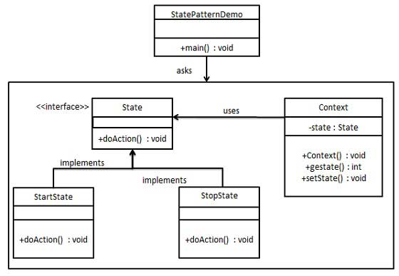
In a state pattern we create objects which represent various states and a context object whose behavior varies as its state object changes.
Notes:
Brief overview

Slide 4
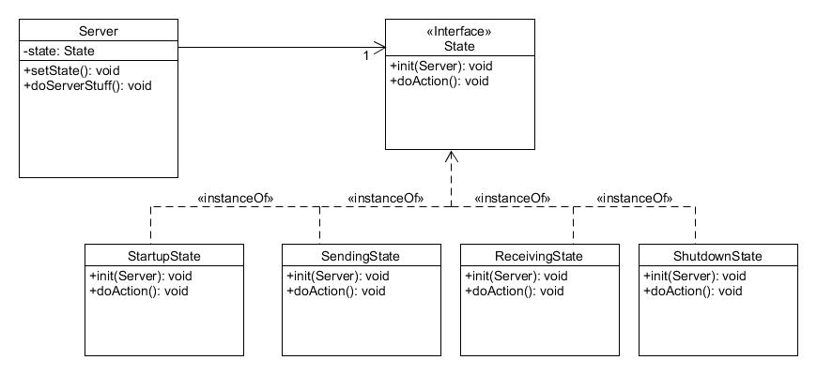
A Server that changes states

Slide 5
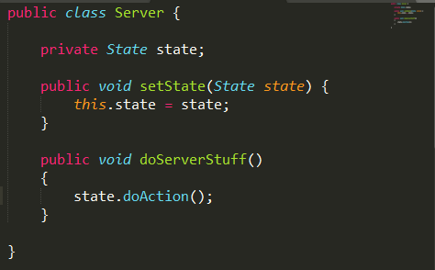
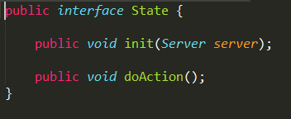
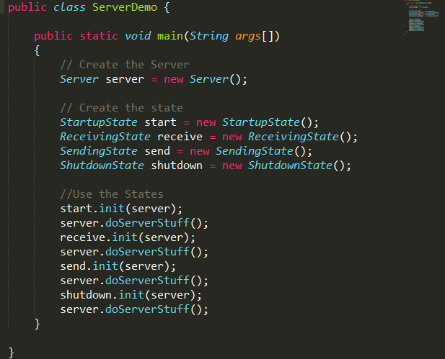
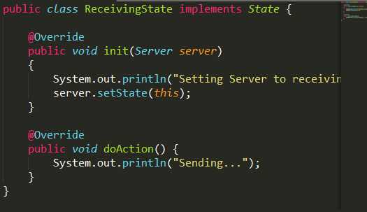

Slide 6
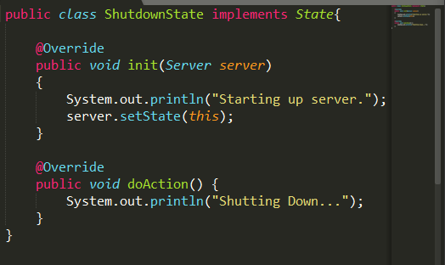
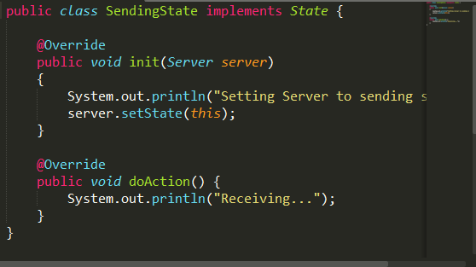
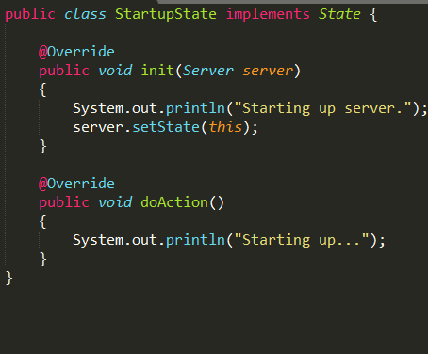

Slide 7
Starting up server.
Starting up...
Setting Server to receiving state.
Sending...
Setting Server to sending state.
Receiving...
Starting up server.
Shutting Down...

Slide 8
Tradeoffs
Non-stable algorithm for implementation
Deals with what the state of an object is, rather than how an object performs a certain task
Must implement the transitions between each state
Not suitable for finite state machines

Slide 9
Additional Problem
Create a server that has conditional state transitions. The conditions for this server are
It must be off to be turned on
It must be on to be turned off
It must be Sending to begin Receiving
It can only turn off after Receiving

